Slide 1
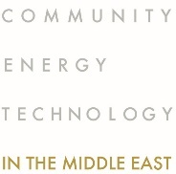
www.comet-me.org
2021
comet-me/2020 presentation / 1

Slide 2
Comet-ME is an Israeli-Palestinian organization providing basic energy and clean water services to off-grid communities using environmentally and socially sustainable methods
comet-me/2020 presentation / 2

Slide 3
comet-me/2020 presentation / 3

Slide 4
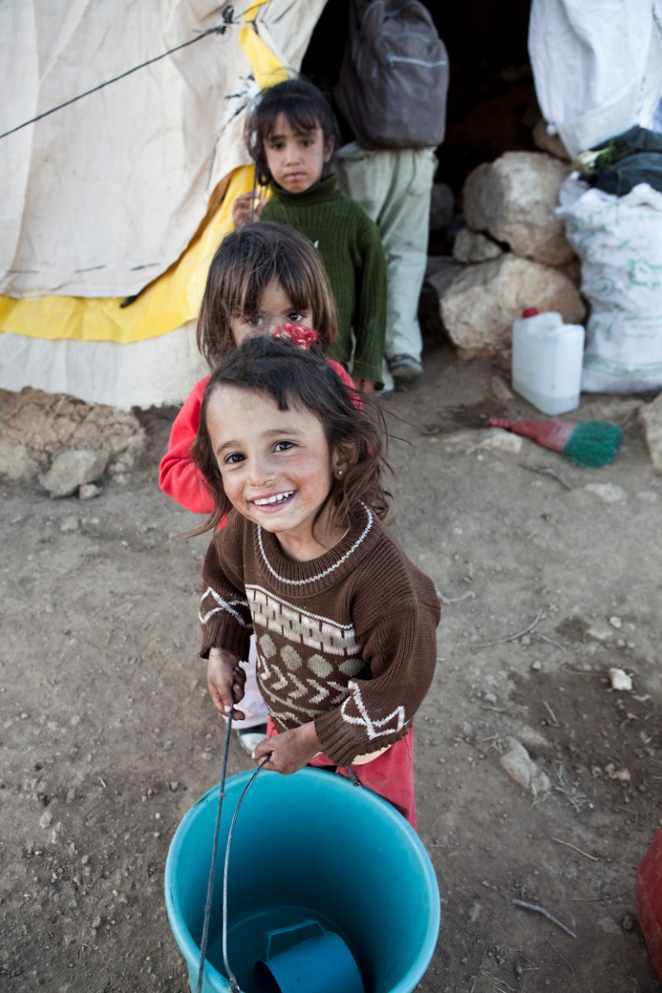
Where we work
Who
Area C of the West Bank
Harsh natural and political climate
Edge of the desert
Political marginalization
Man-made de-development
Clear and ongoing attempt by the Israeli authorities to move civilian population
Pervasive violence by both the military and authorities
comet-me/2020 presentation / 4

Slide 5
What we do
Who
Since 2009: Installation of renewable energy systems (wind and solar): 70 communities / 8000 people
Since 2013: Clean water services
Capacity building
Long term stewardship of the infrastructure
comet-me/2020 presentation / 5

Slide 6
Electricity
Who
Basic Energy Services – 2.5 kWh/Day/Family
Illumination
Communication
Refrigeration
Butter churning
Laundry
comet-me/2020 presentation / 6

Slide 7
How we do it
Who
Comet-ME is a hybrid between a grassroots political organization and a small, vertically integrated electric utility.
Service provision – a long term approach where the installation of the system is “only” a key component, not the entire project.
Users pay for the service – builds a sense of ownership and rationalizes the use of energy
A marathon, not a sprint
comet-me/2020 presentation / 6

Slide 8
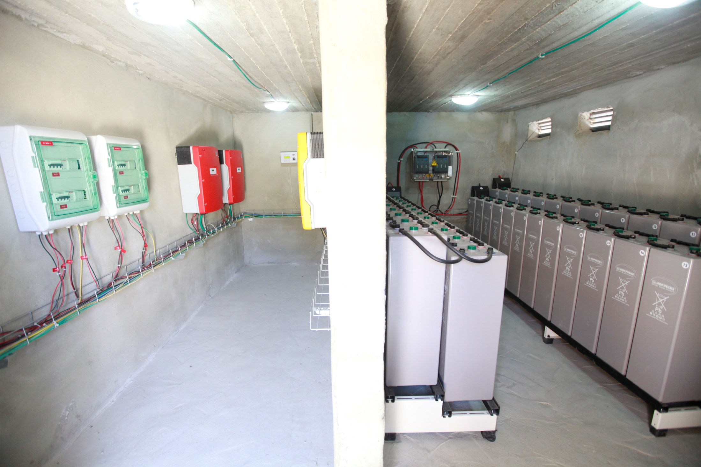

Slide 9
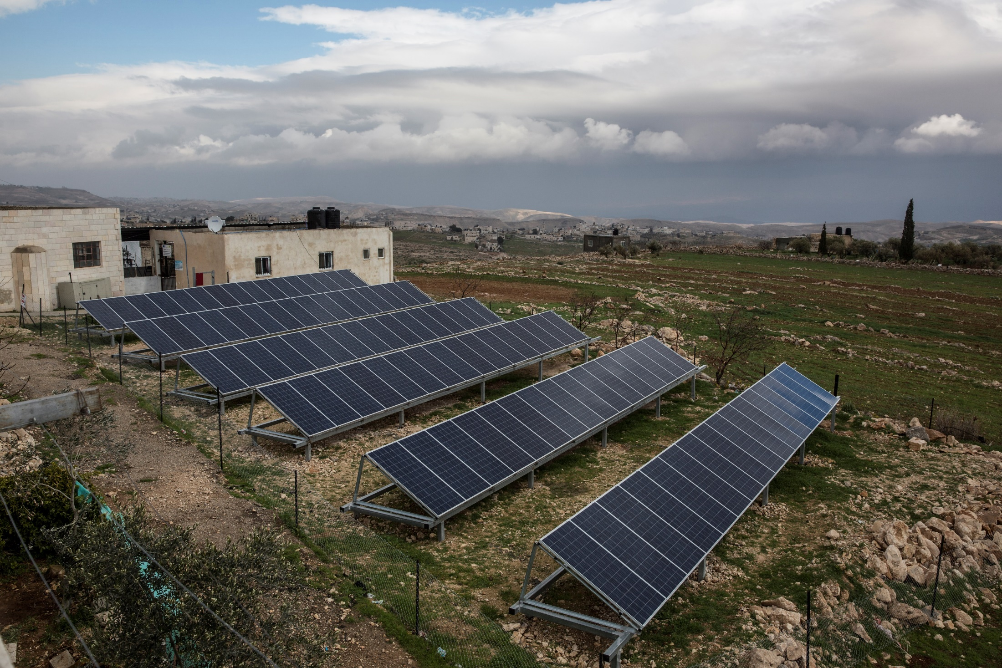

Slide 10
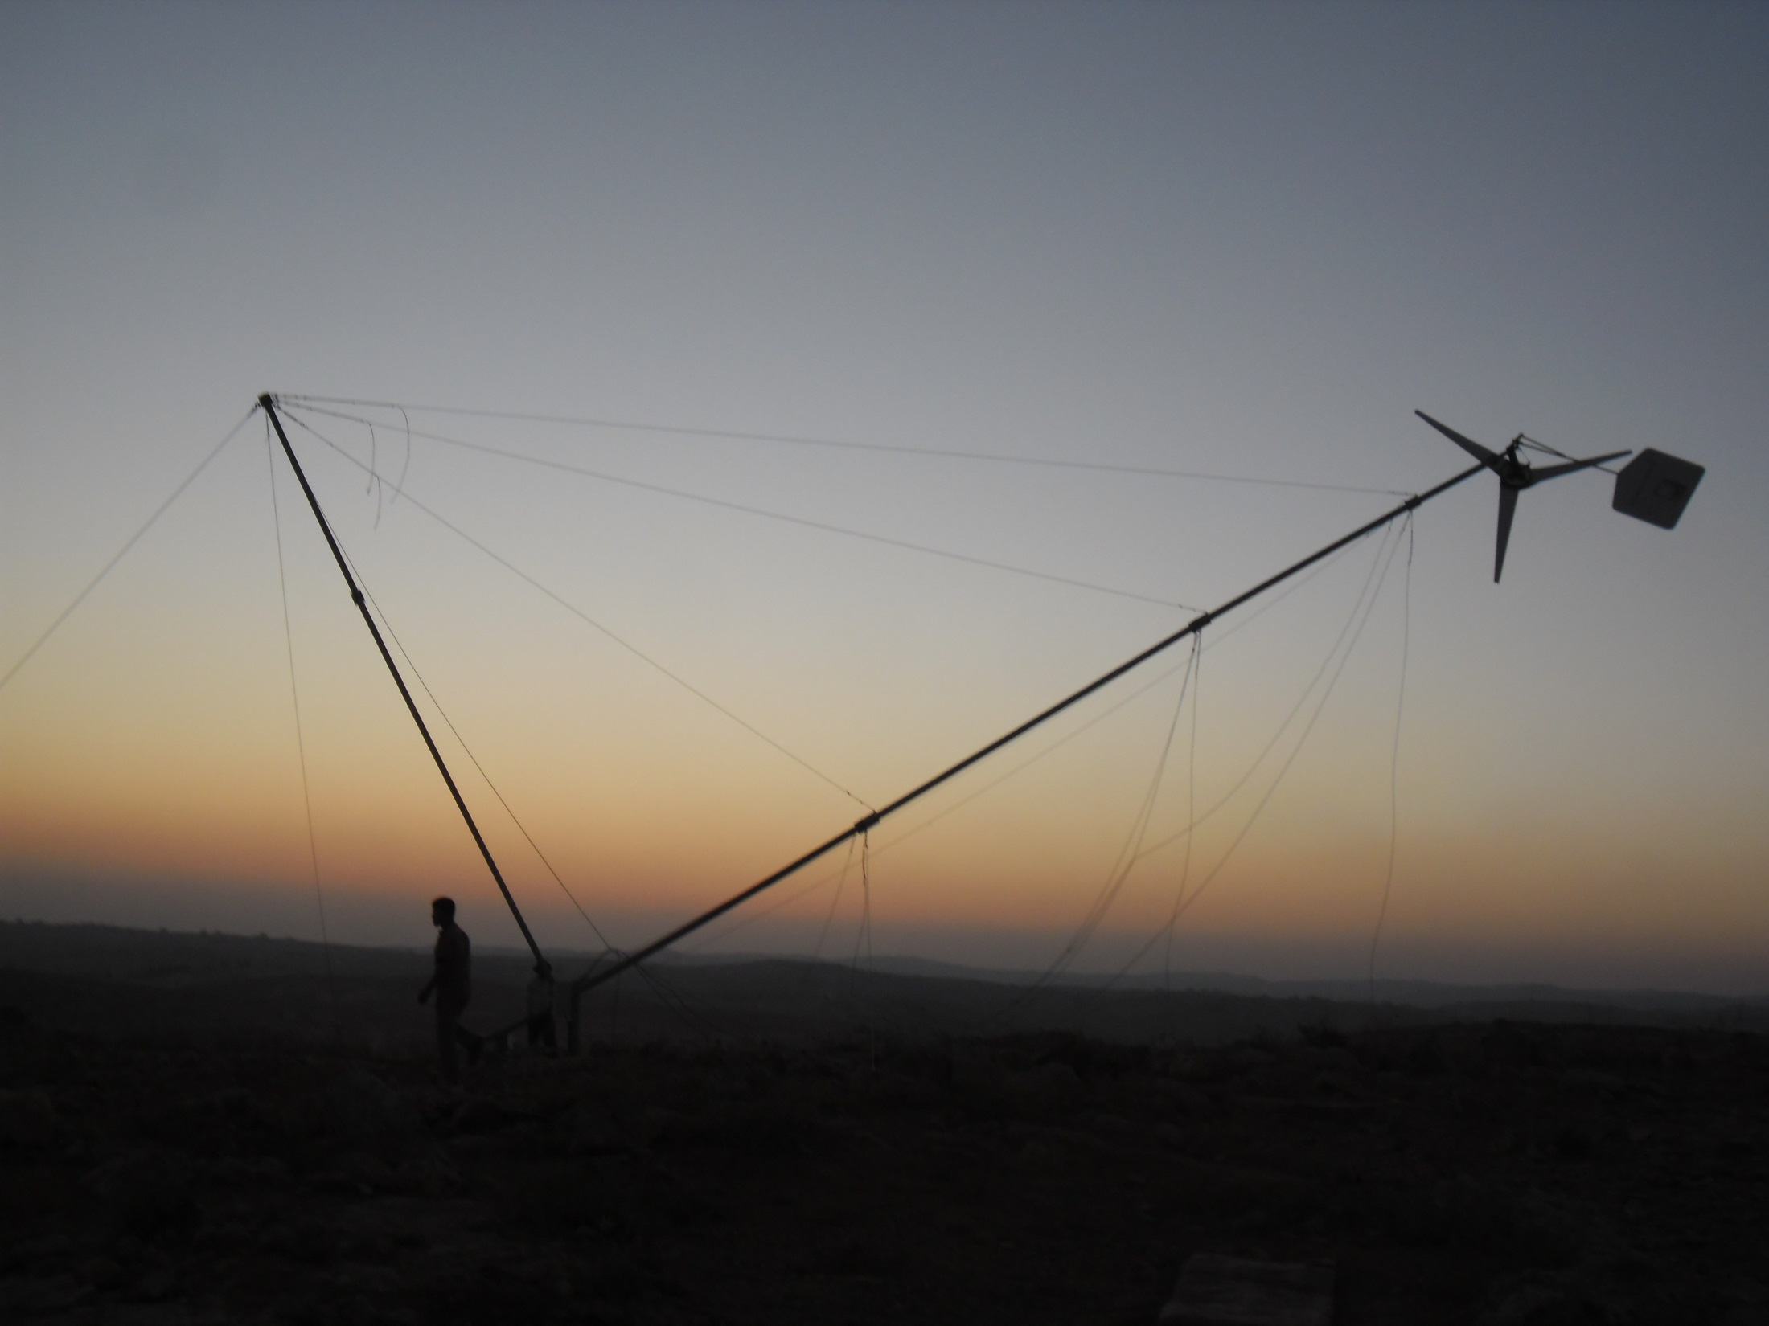

Slide 11
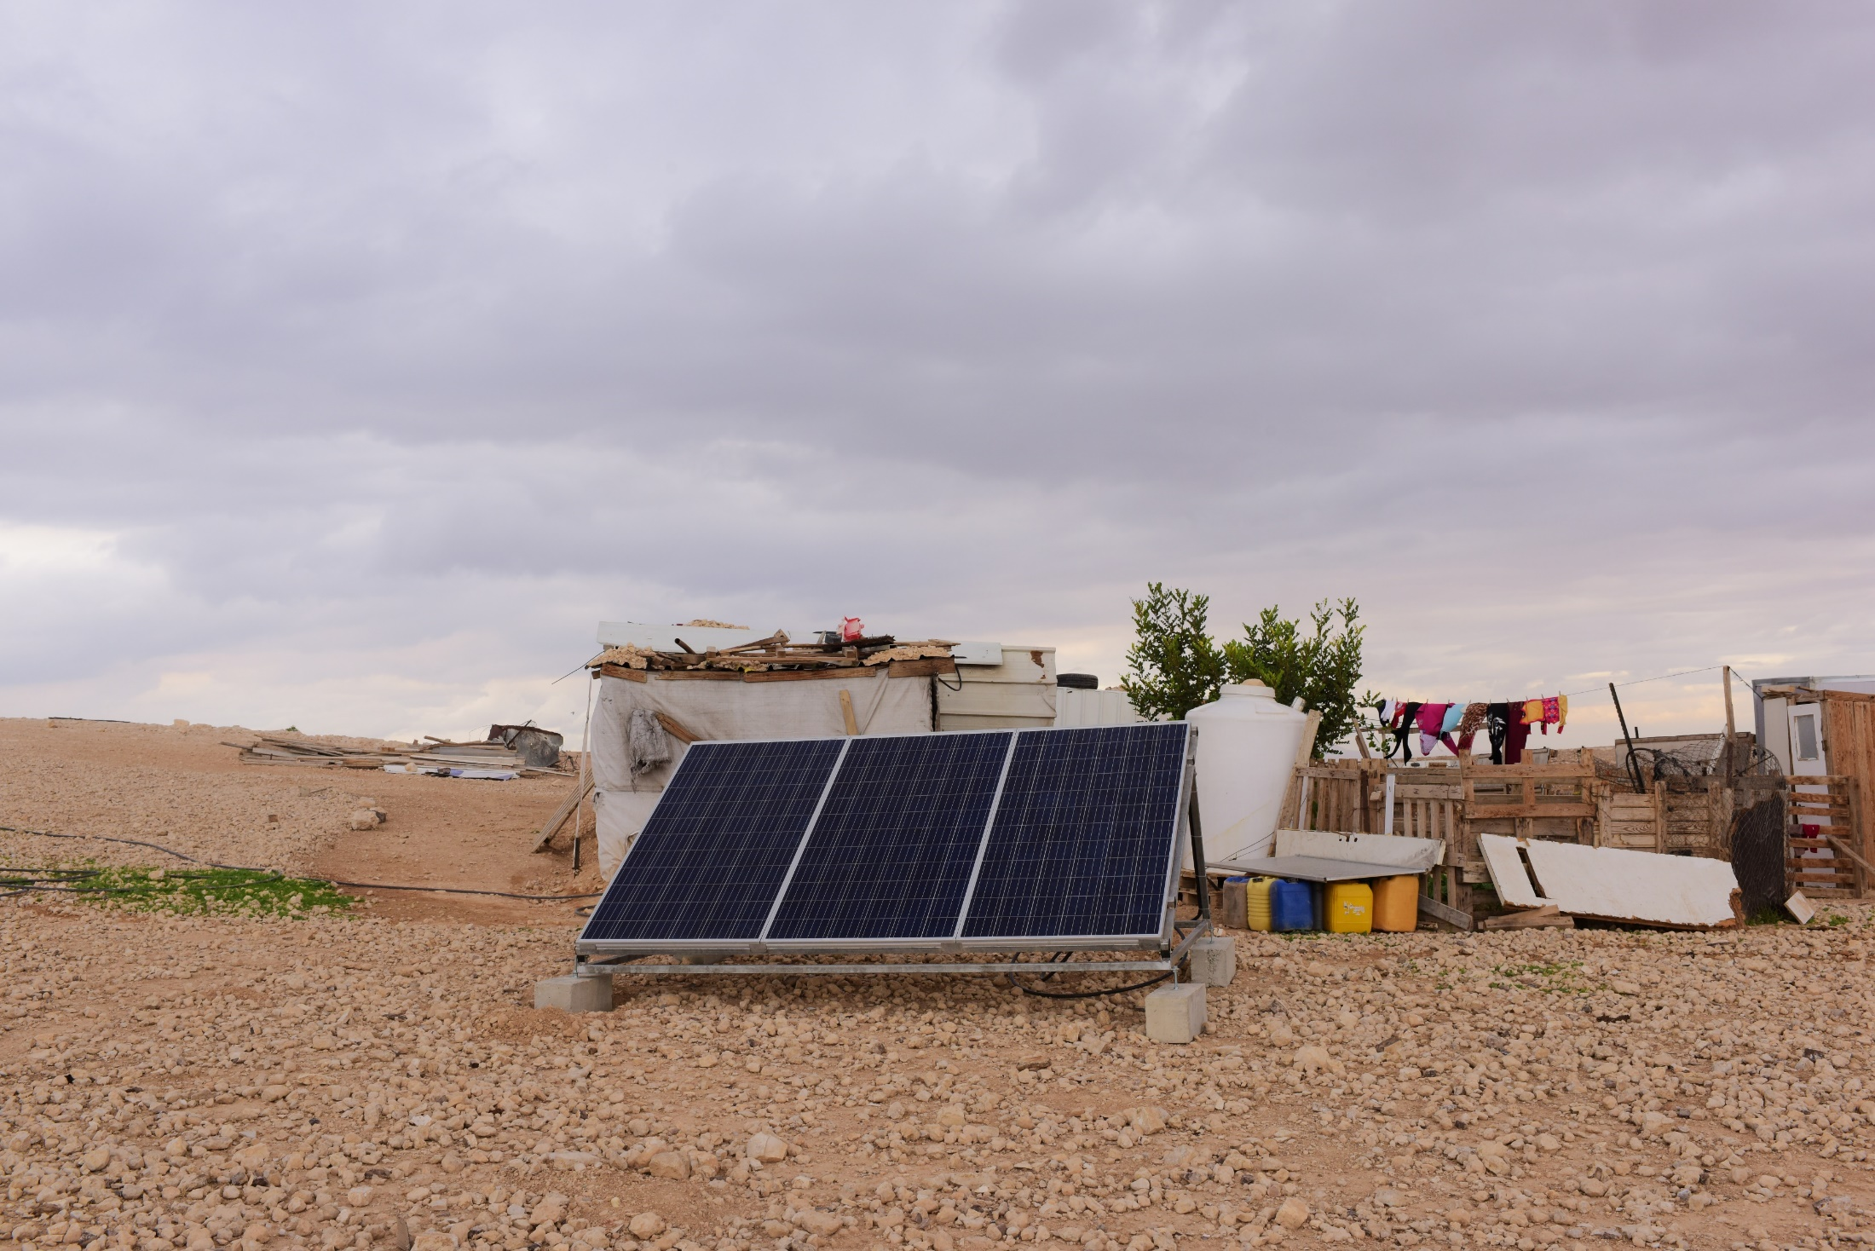

Slide 12
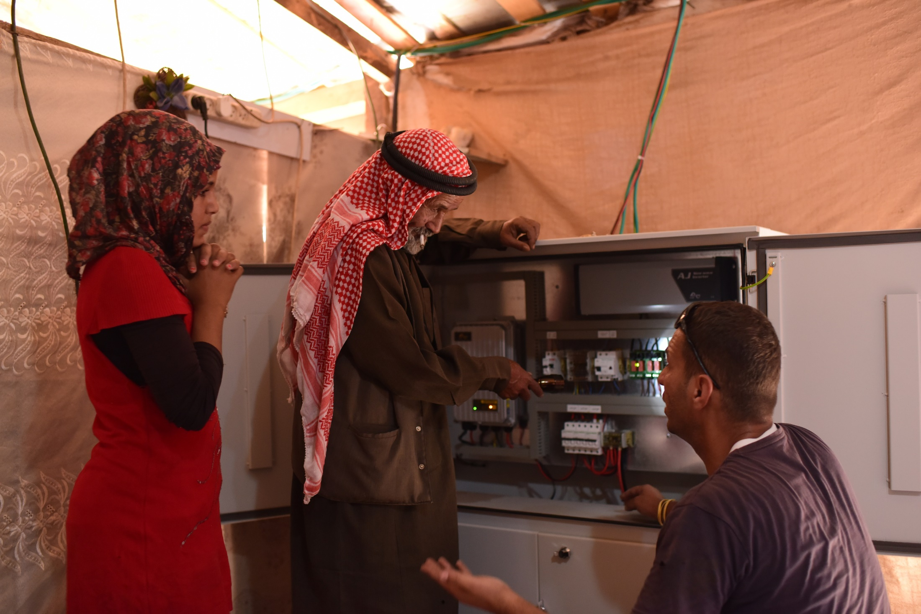

Slide 13
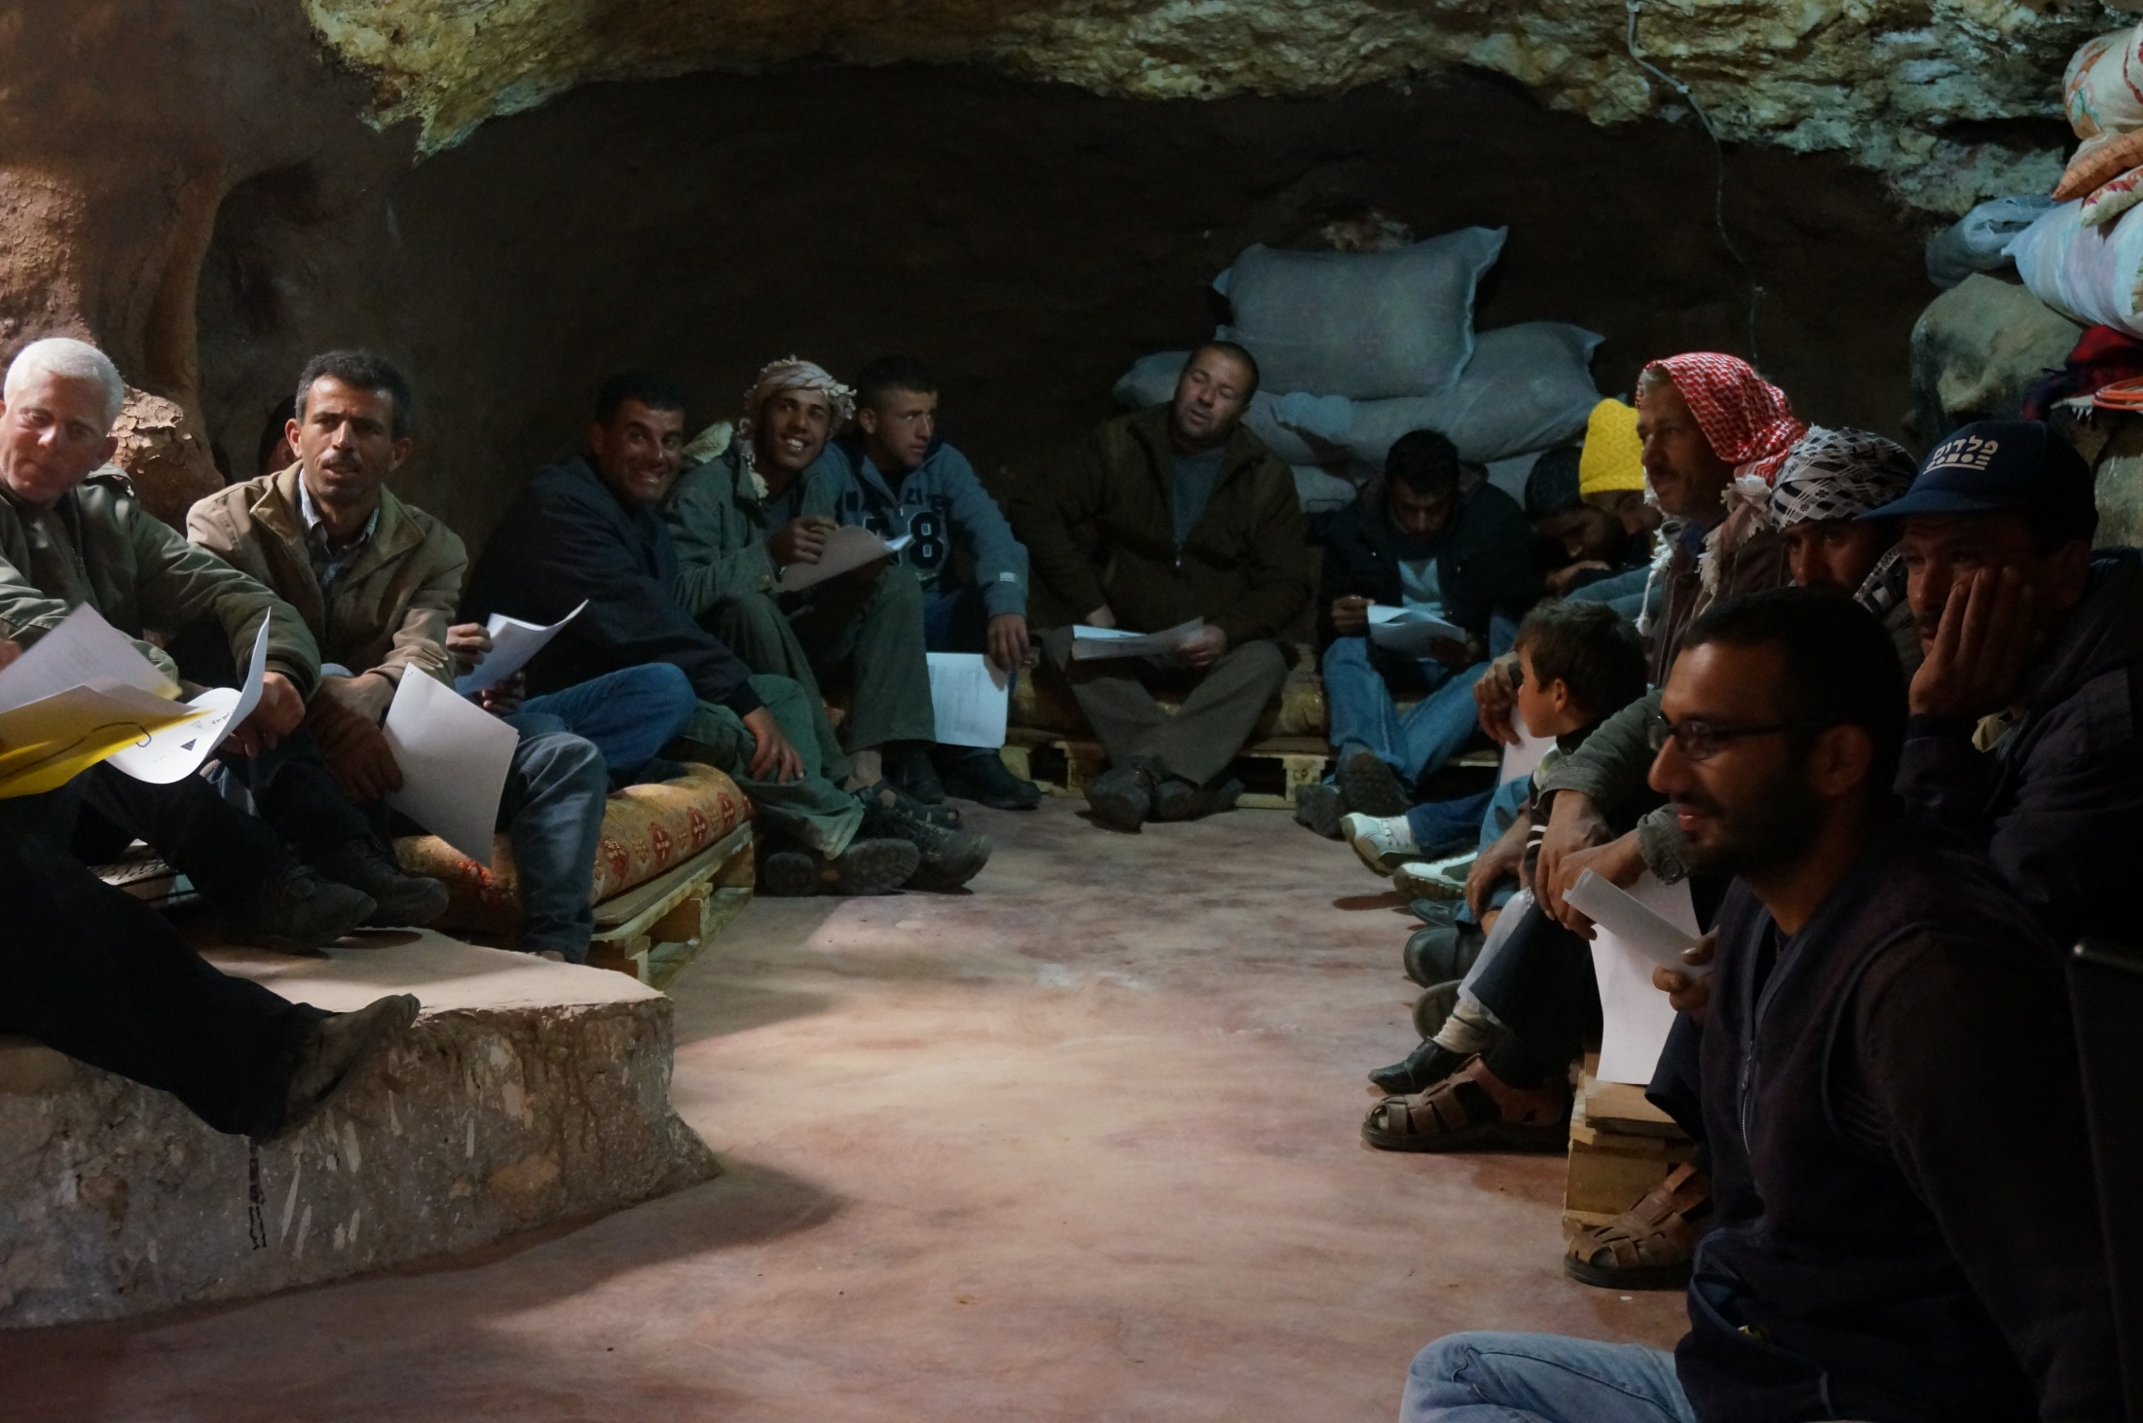

Slide 14
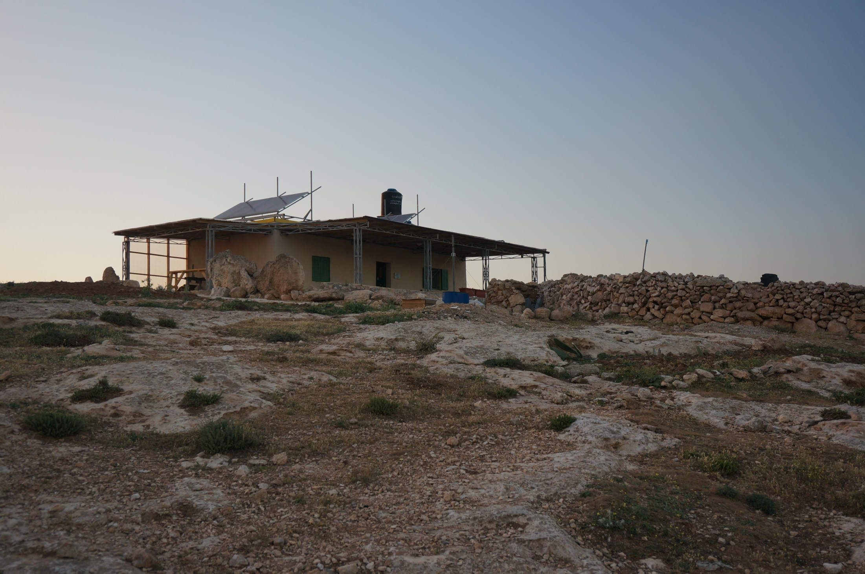

Slide 15
Closing words
Who
Long range approach
Understand the context
Treat the people you are working with like adults, no condescending, no discounts
Humility
There is no substitute for “walking the walk”
comet-me/2020 presentation / 15

Slide 16
Thank you
www.comet-me.org
info@comet-me.org
comet-me/2020 presentation / 16

